Slide 1

Attend-in

Slide 2
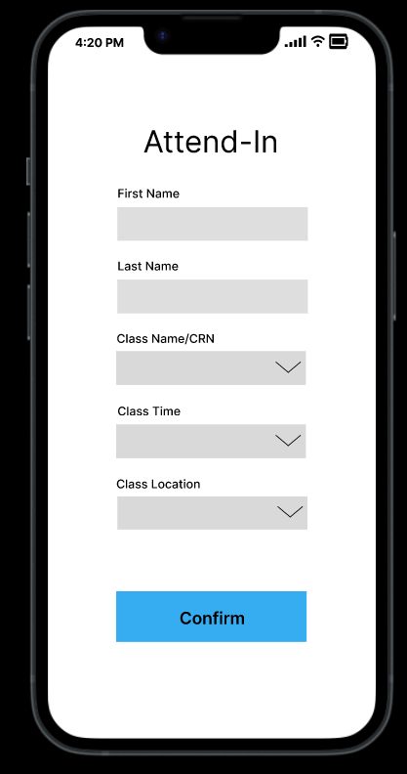
Purpose of Software System
Chosen Topic: Attend-in
The Attend-in apps’ main purpose is to make the process of recording attendance easier for both the students and the professors.
The Attend-in app allows students to submit their attendance through an app on their phone by tracking the students’ location.
The app allows professors to record the attendance through the app instead of taking attendance manually.

Slide 3

Technical Platform
The technical platform our team chose for the Attend-in app is Android Studio.
Android studio is a good choice because it contains most of the features and tools required to build our app.
It also provides easy access to databases which will be helpful in storing the geolocation data.

Slide 4
Story Board 1

Slide 5
As the student, I should be able to enter my first and last name in the app so that the professor is able to recognize who I am.
As the student, I should be able to pick a class so that I can submit attendance for the right class.
As a student, I should be able to pick the time and location of my class so that I can submit attendance for the right class.
As a student, I should be able to press the confirm button so I can submit my attendance.
Pass
Fail
As a student, I should receive a confirmation message after submitting attendance so that I know that I have been marked as present.
As a student, I should receive an error message, and should be able to retry submitting my attendance so that I know I entered wrong information and need to try again.

Slide 6
Story Board 2

Slide 7
As the professor, I want to be able to go to the app and select the class so that I can see the attendance for a specific class.
As the professor I want to be able to see all the students in the selected class so that I know who is in the class.
As the professor, I want to be able to see which students submitted their attendance successfully, so I know what students are present in class.

Slide 8
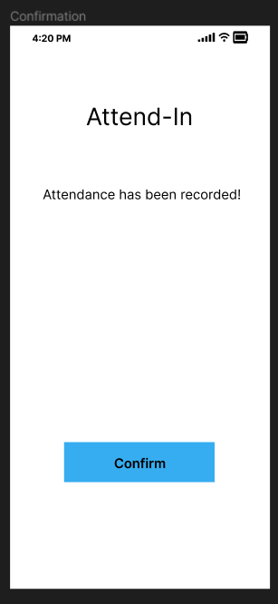
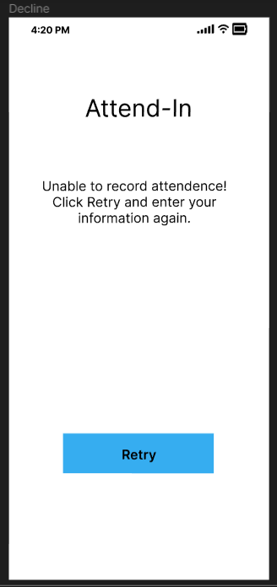
Screen Examples

Slide 9
Thank you!

